Slide 1
Engineer Your Life – Bailey Edition
Bailey Wu
Mechanical Engineering
September 1st, 2025

Slide 2

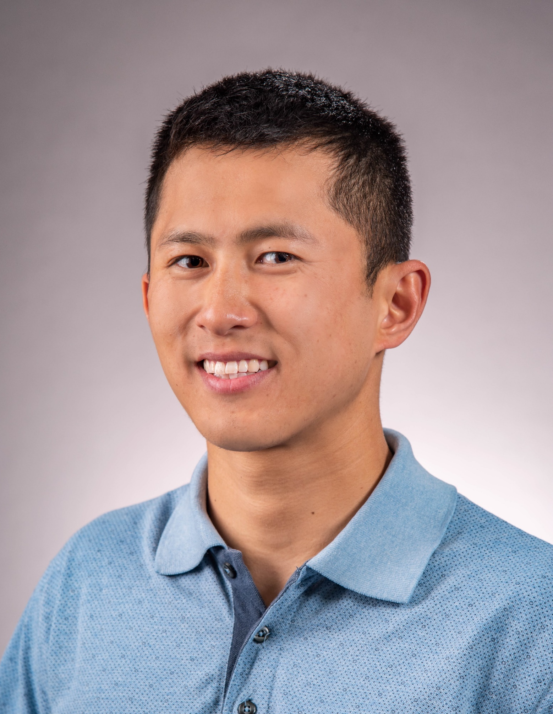





Background
B.S. Mechanical Engineering, University of California, Santa Barbara
M.S. Mechanical Engineering, University of Washington
Aerospace Industry (Boeing, Lockheed Martin, Raytheon)
Roles in Manufacturing, Process, Design
Outside of Work: FIRST Robotics, Ultimate Frisbee
Bailey Wu
baileywu@uw.edu

Slide 3
Purpose
The purpose of this presentation is making space for:
Reflecting on my career and lessons learned
Establishing what’s important to me and my life values
Documenting helpful exercises that give me clarity on my priorities
Setting myself up for success for a transition / new chapter

Slide 4
Agenda
Sections:
I. Career Journey
Navigating the Manufacturing Landscape
Optimizing Processes for Success
Innovative Design: Shaping the Future
II. Personal Reflection
Prioritizing What Matters: Important vs. Urgent
Cultivating Creative Spaces for Growth
Envisioning My Ideal Life: Bridging Aspirations and Reality
III. Taking Action
Leveraging Informational Interviews for Insight
Charting My Next Chapter: Goals and Aspirations
Empowering Myself: Finding My Voice in the Journey

Slide 5
Agenda
Sections:
Career Journey
Manufacturing
Process
Design
Personal Reflection
Important vs Urgent
Creative Spaces
My Ideal Life
The Gap vs The Gain
Taking Action
Informational Interviews
My next chapter
Finding my voice

Slide 6
Career Reflection

Slide 7
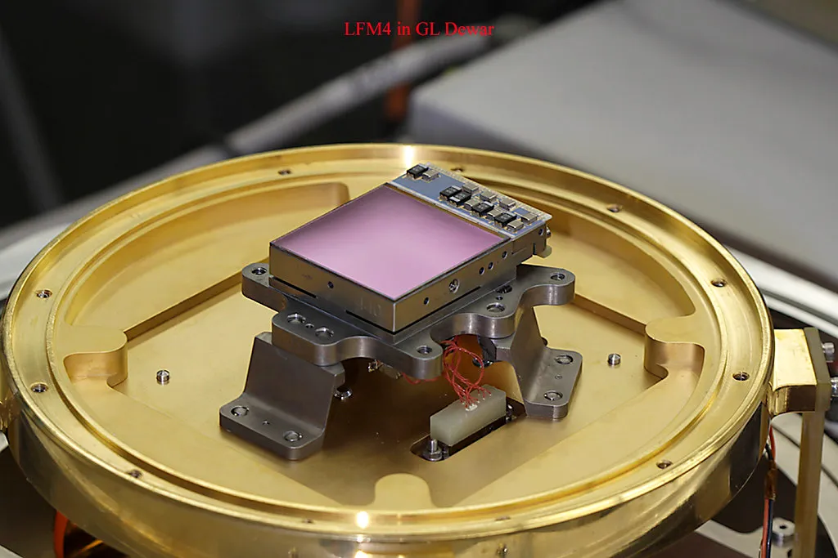
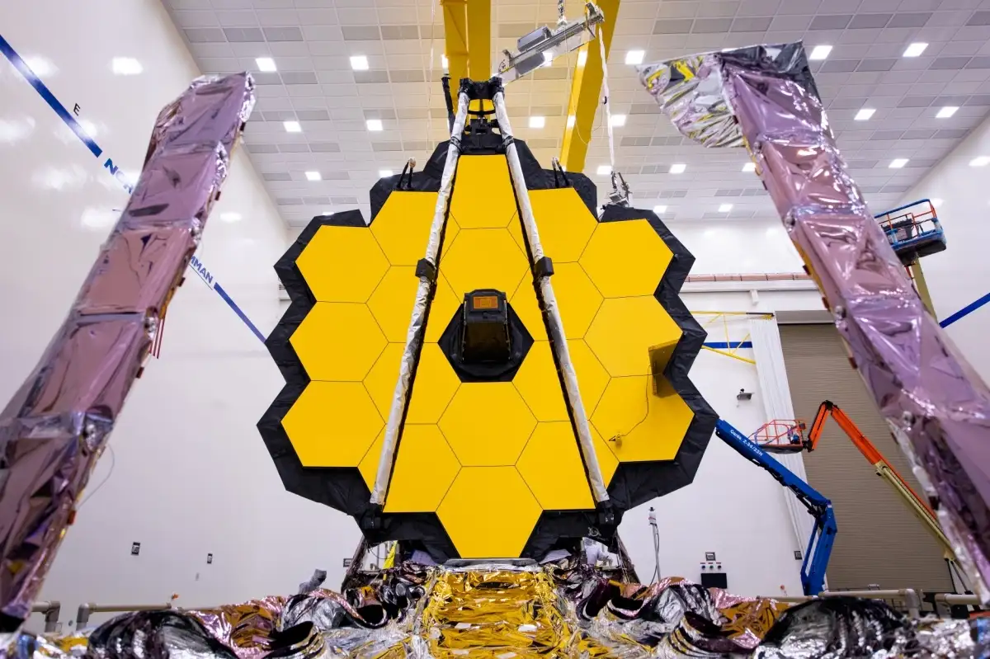
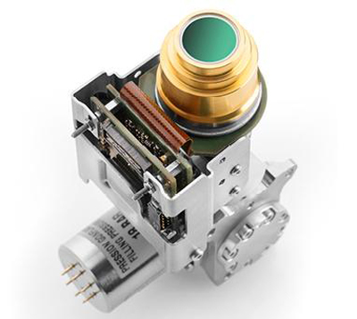
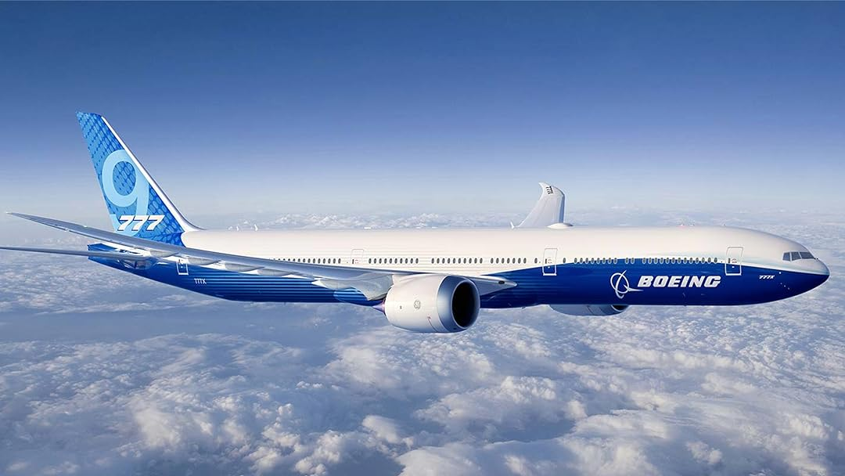
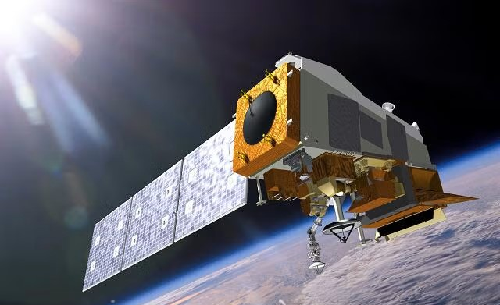
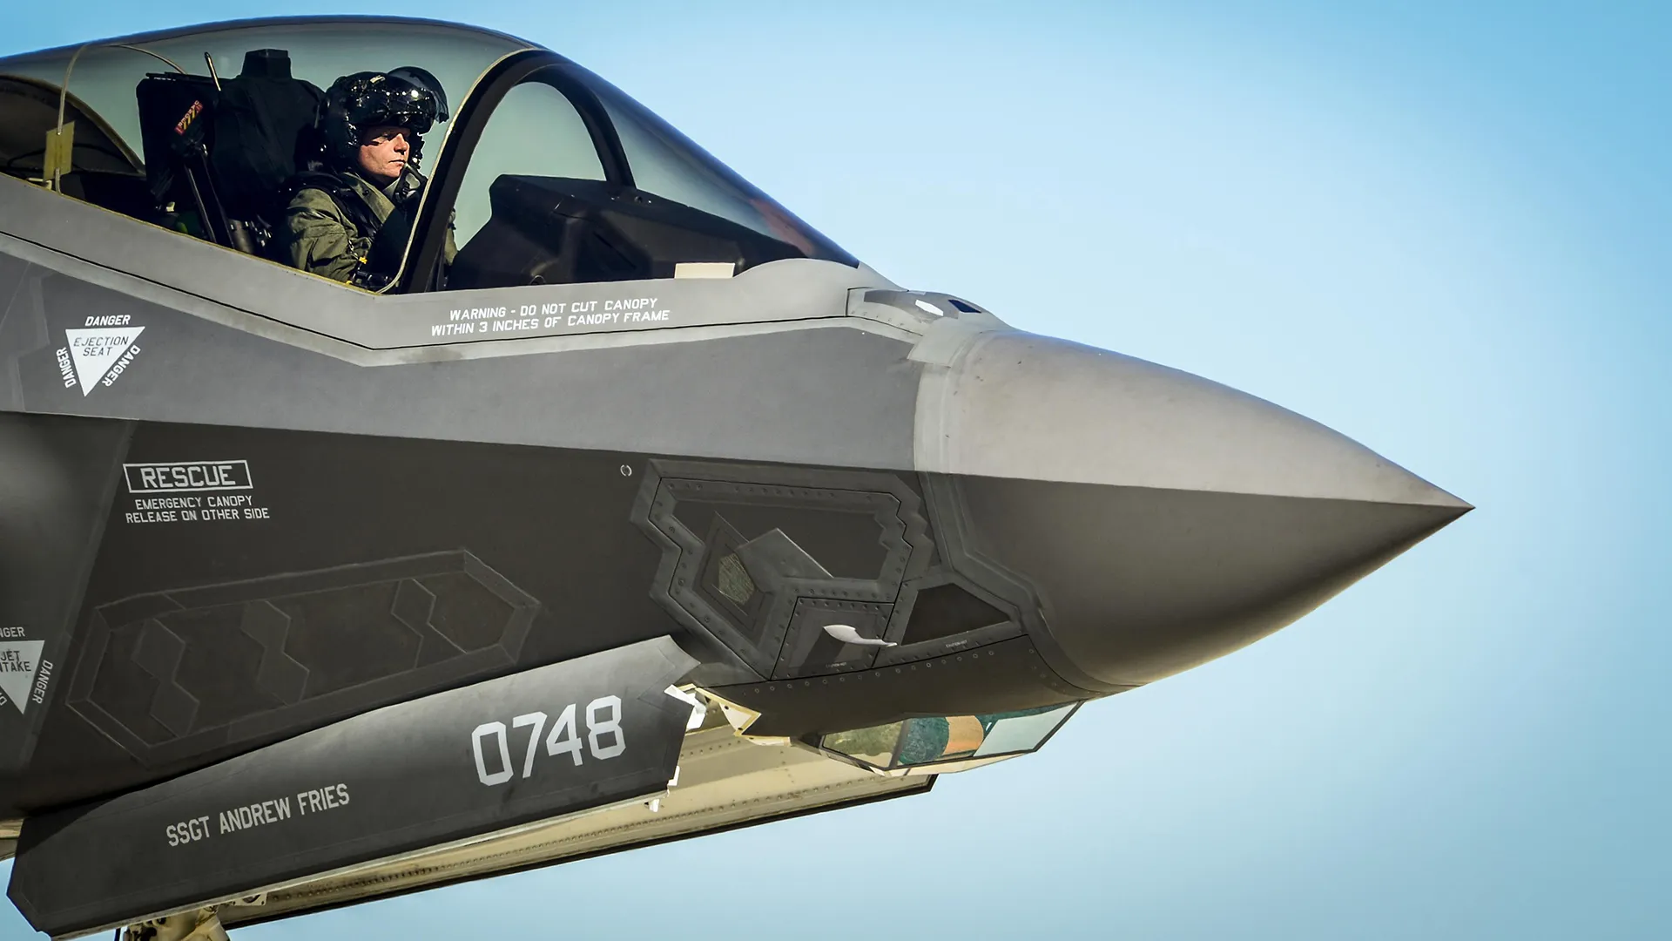
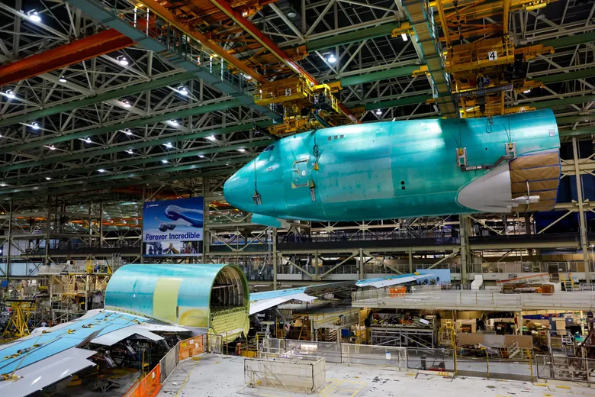
Career Timeline
Manufacturing
Process
Design
2018 - 2021
2021 - 2024
2024 - Present

Slide 8
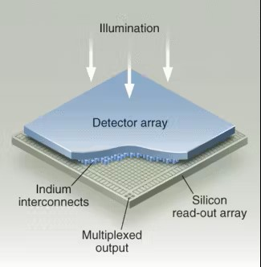
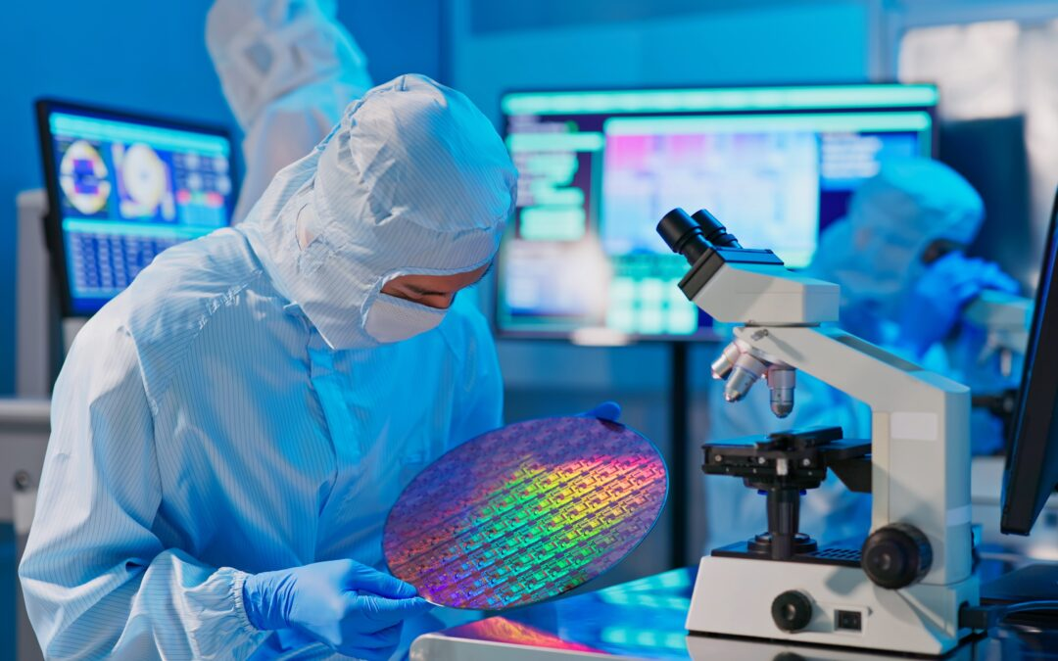
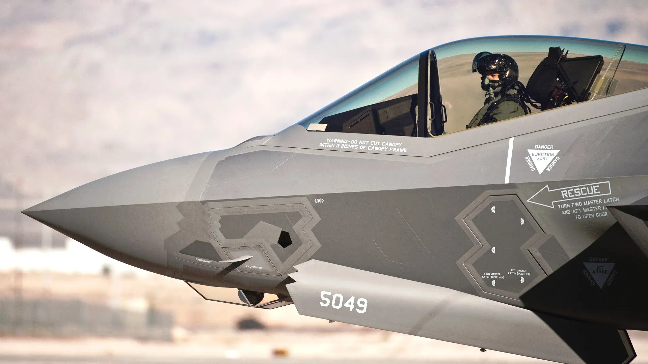
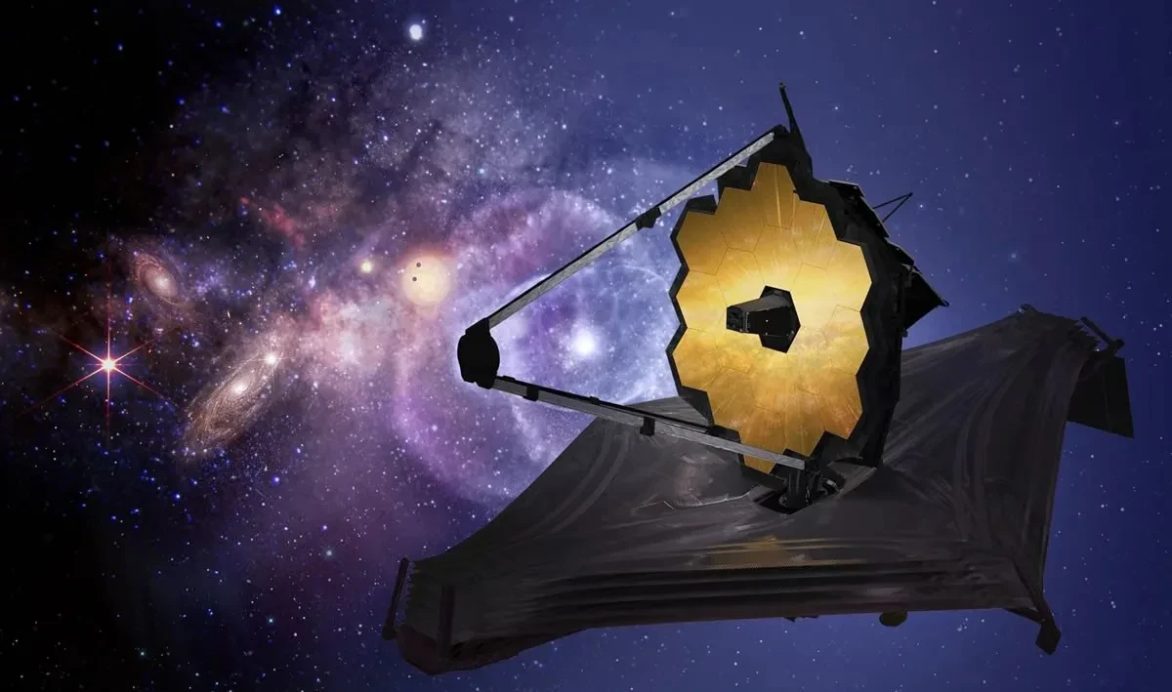
Manufacturing Engineer – Raytheon
Raytheon Vision Systems
Goleta, California
2018 – 2021

Slide 9
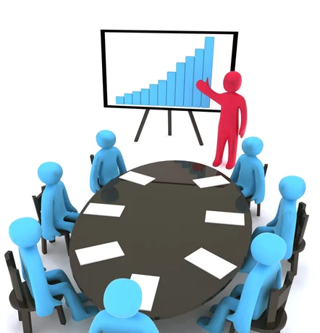
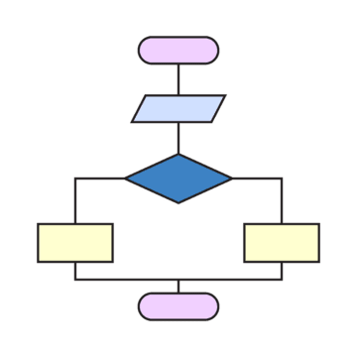
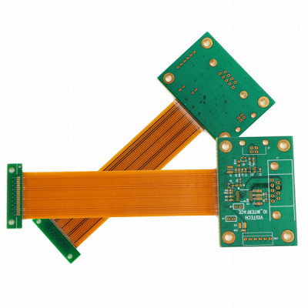
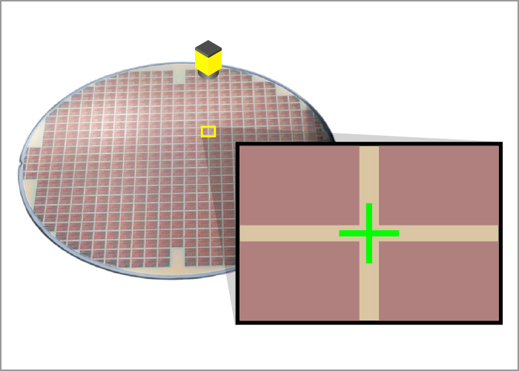
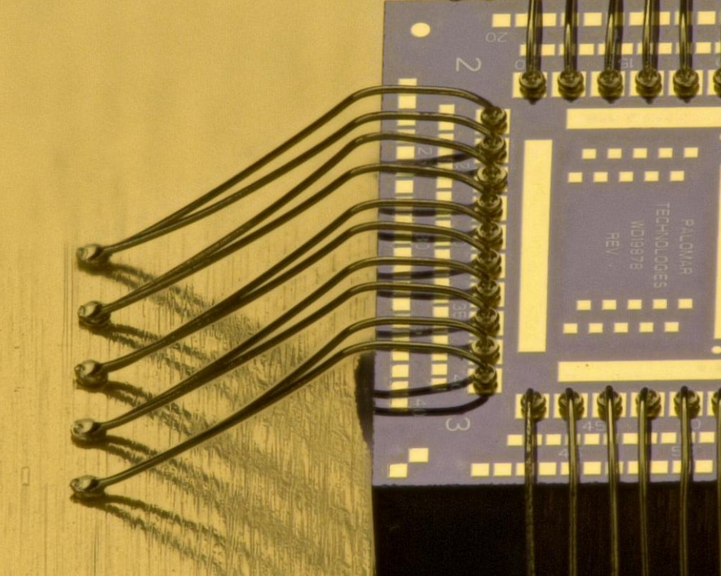
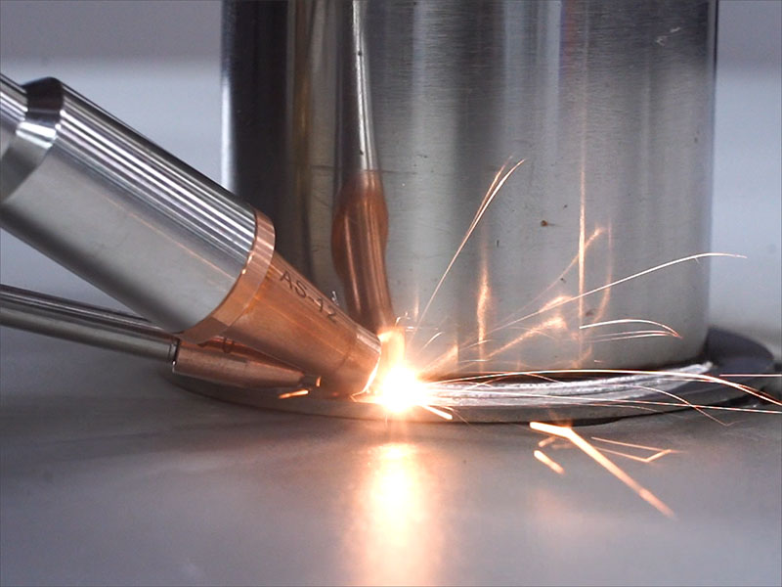
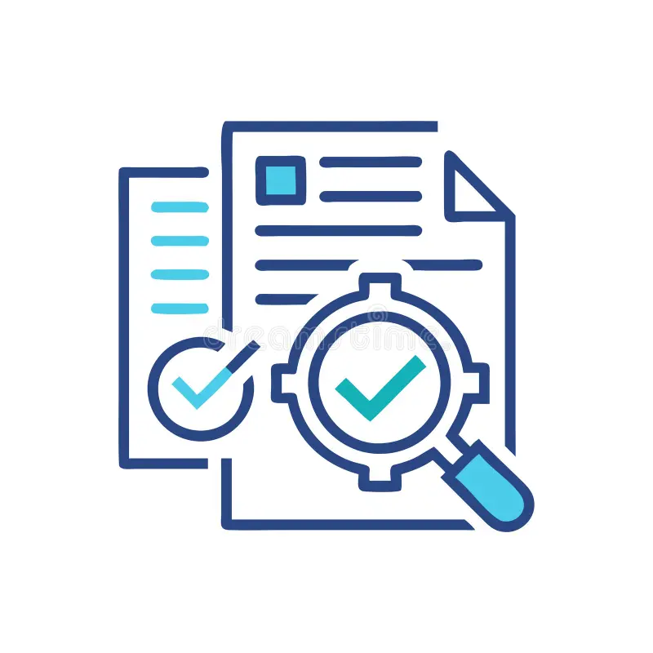

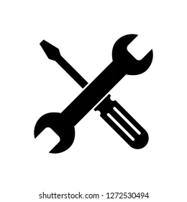
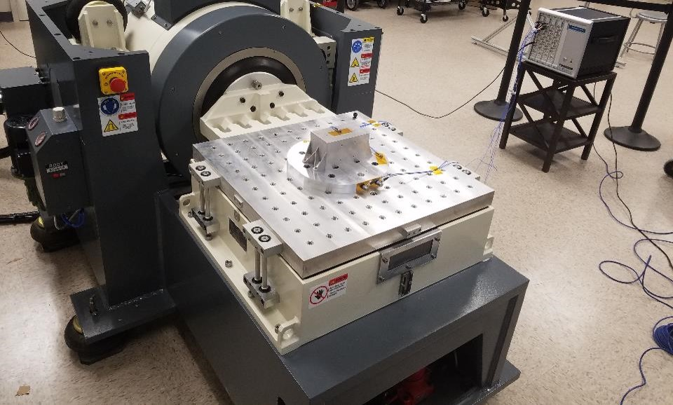

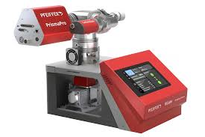
Manufacturing Engineer
Product Roadmap
Planning
Production
Design Reviews
(PDR / CDR)
Build
Plan
Supplier Quality
Precision Alignment
Wire
Bonding
Laser
Welding
Customer Buy Off
Certification Testing
End Item
Data Package
Delivery
Shipment
Rework
(As Needed)
Vibration
Testing
Thermal
Cycling
Residual Gas Analysis

Slide 10
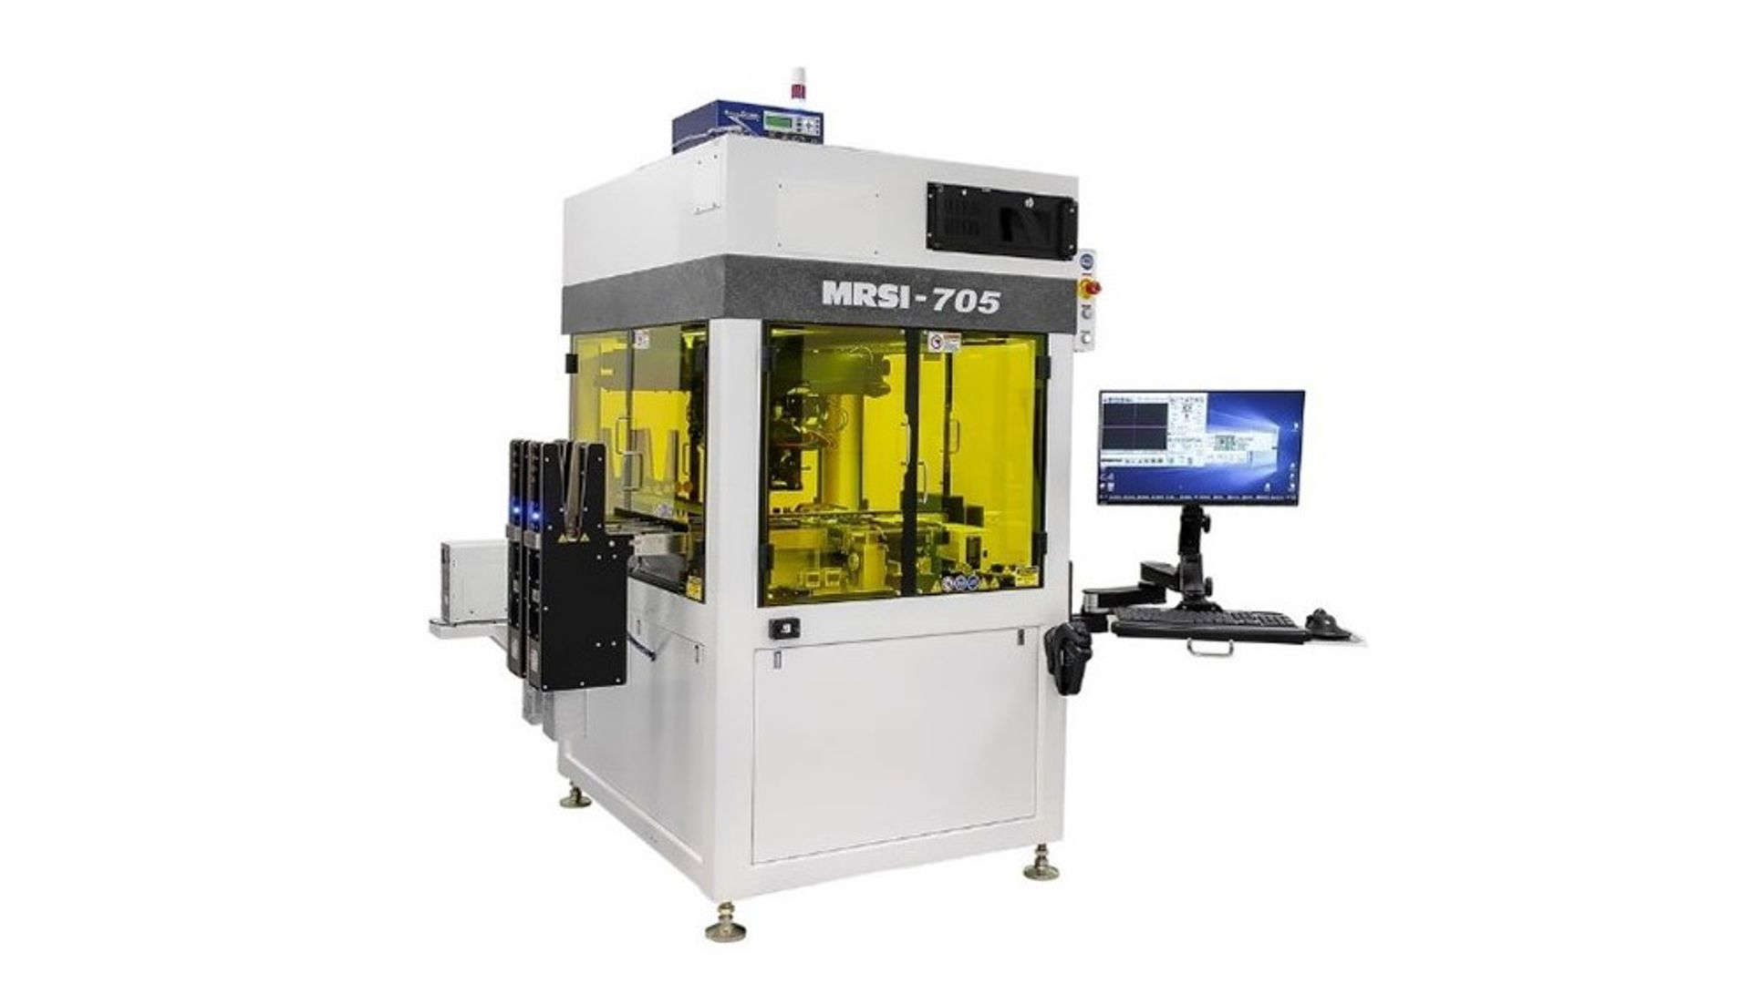
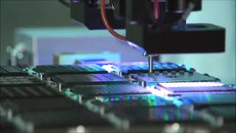
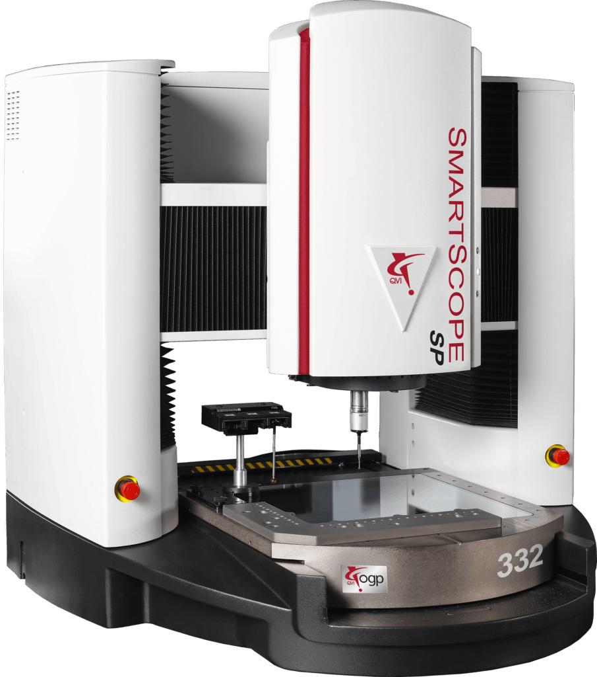
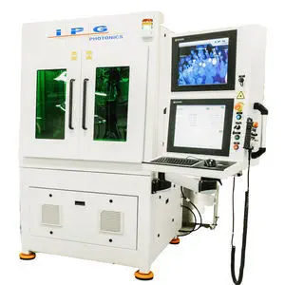
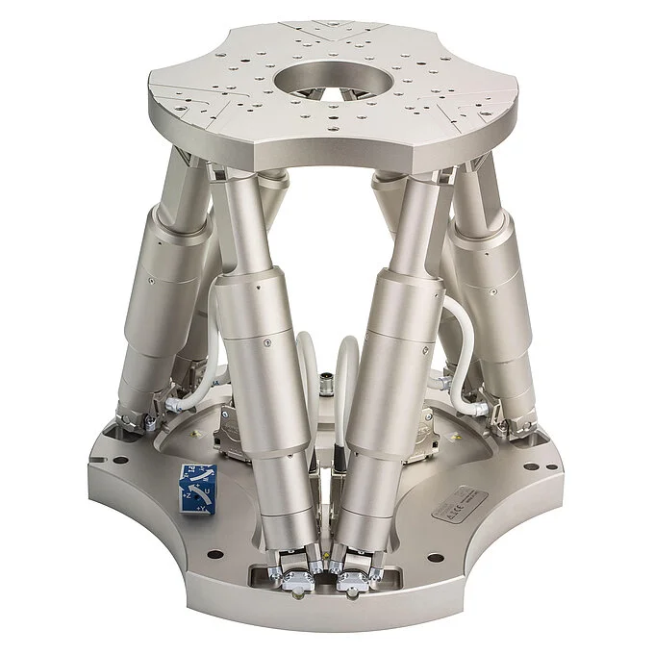
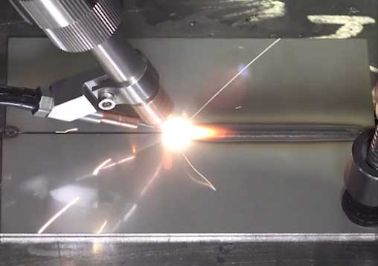
Process Engineer – Raytheon & Lockheed
Raytheon Vision Systems & Lockheed Missiles Fire Control
Goleta, California
2021 – 2024

Slide 11
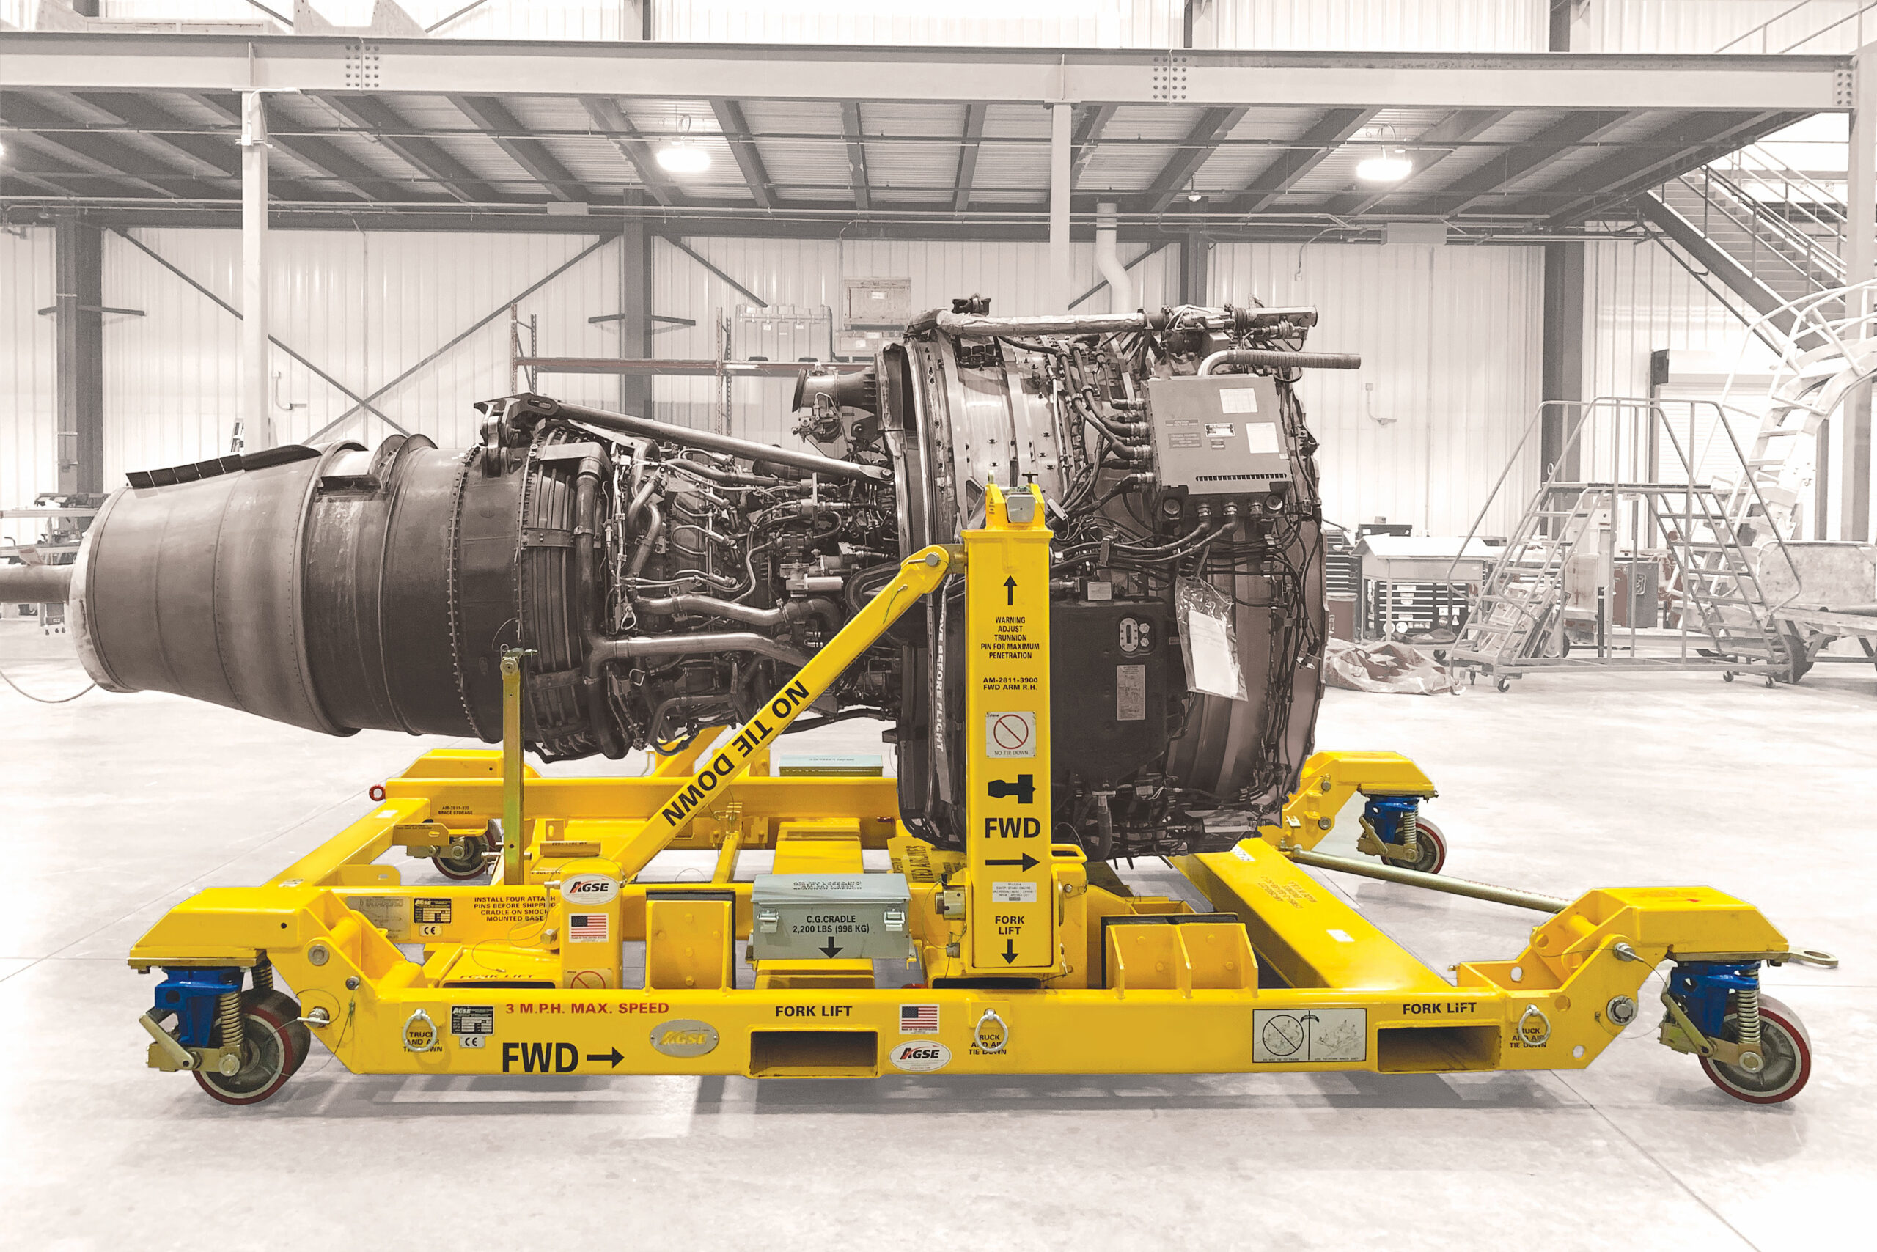
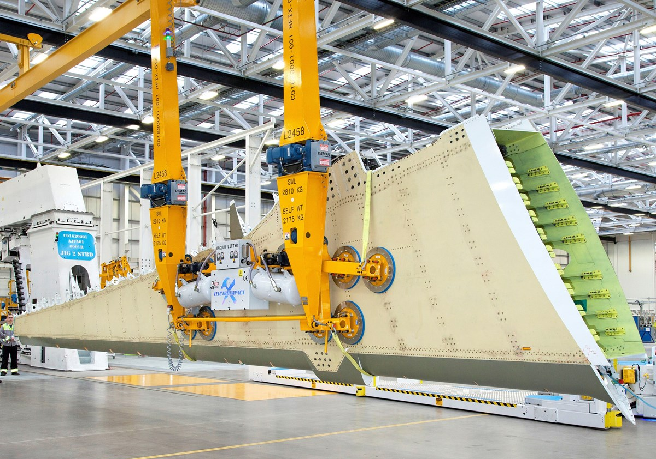
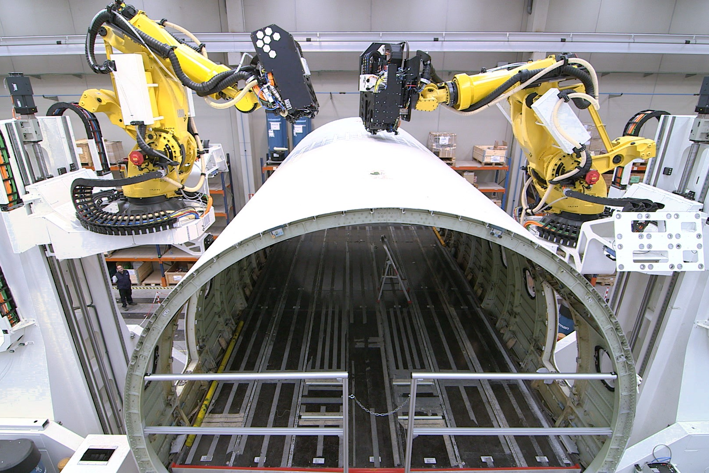
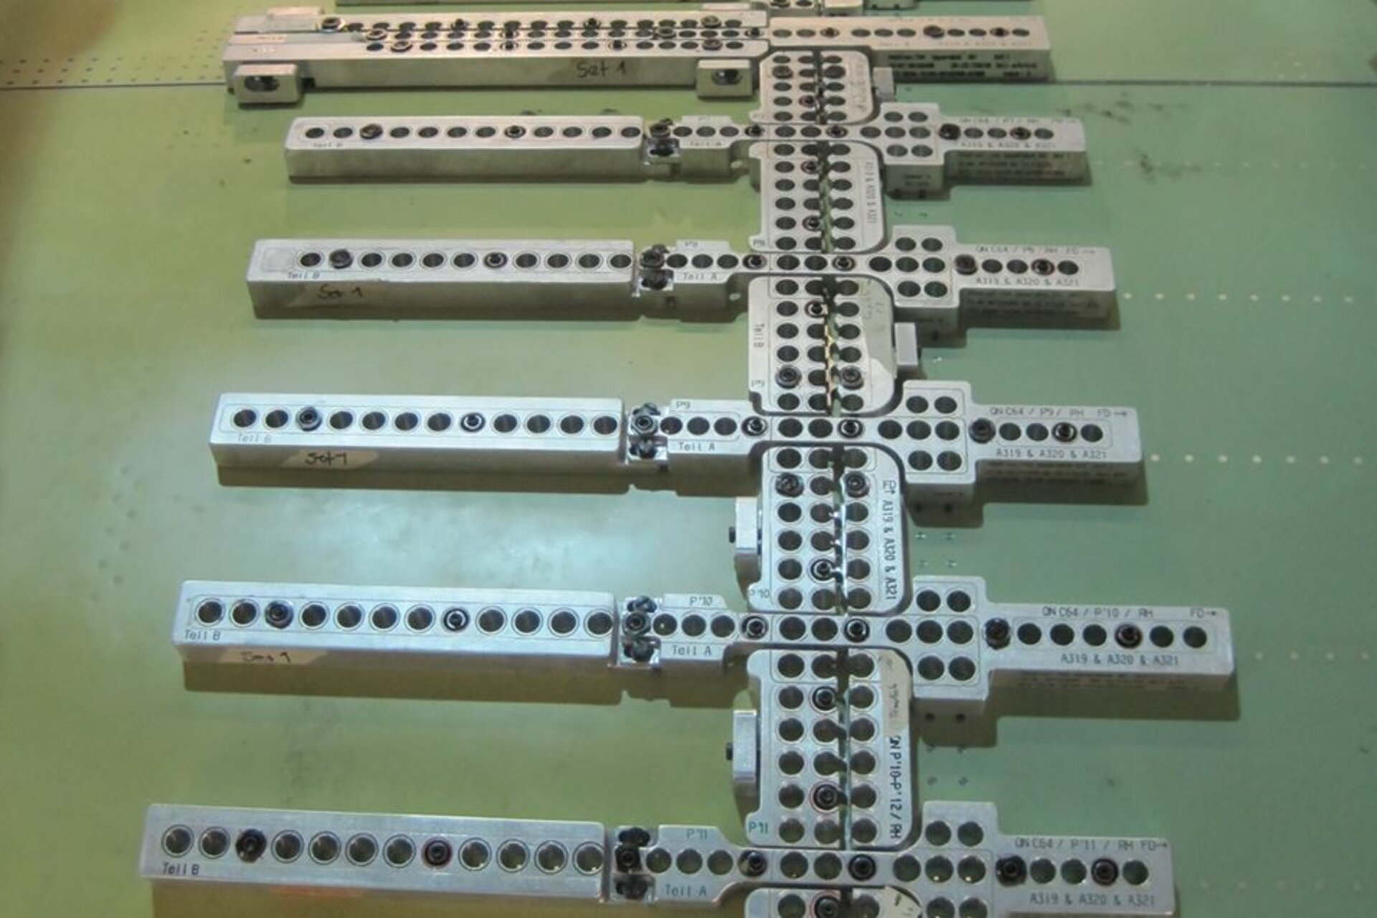
Tooling Design Engineer – Boeing
Boeing Commercial Airplanes
Everett, WA
2024 – Present

Slide 12
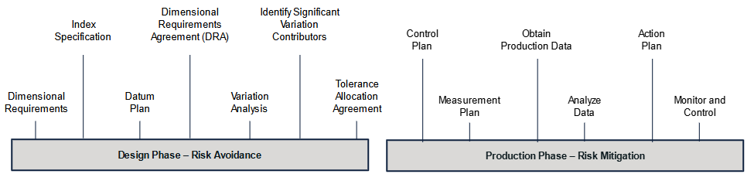
Lessons Learned
Documentation – Writing things down can save time in the future
Curiosity – Continue to ask “why” to understand the bigger picture
Collaboration – Be able to work with people of all backgrounds
Notes:
Hard to fit all my lessons learned in one slide but here are the most important ones I’ve found across the industries
Build trust & relationships with the people doing the work (technicians, mechanics, operators, etc.)
Challenges are easier with a supportive team
Put in the work first / attempt a problem before asking for direction guidance from a professor or mentor

Slide 13
Personal Reflection

Slide 14
Strong Beam, Stronger Column
Relationships
Health
Career
Personal Growth
Relationships
Family
Friends
Naomi
Community
Teammates
Health
Fitness
Sports
Traveling
Nutrition
Mood
Career
Balance
Aligned Product
Supportive Team
Stimulating Work
Income
Personal
Creativity
Coaching
Writing
Volunteering

Slide 15



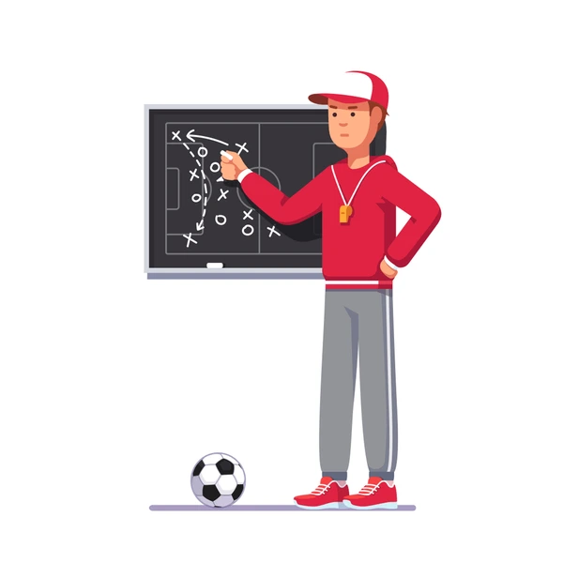
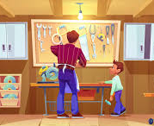

My Ideal Life
Notes:
Relationships:
Maintain strong relationships with Family and Friends
Being there for big life moments & milestones (weddings, family trips, funerals,)
(I never want to miss something because I’m stuck at work)
Home:
Stability and Security - a sense of permanence and laying down roots. Renting feels temporary
Building relationships with neighbors, the community, and being able to have guests and host parties
Learning the process of being a homeowner & work on home projects to personalize my space
Having a place to showcase my life through decoration, photos, home projects, etc.
Stability – Strong Beam, Stronger Column
Financial Benefits
Adventures & Health:
Having someone to share my life with and experience adventures together
Resetting through nature, exploration, traveling
Maintaining healthy habits (exercising & nutrition) to be able to do that
Creative Space:
Having a space to continue being creative outside of work
Ideally combines with my passion of being a mentor
I’ve found that coaching sports is a perfect way to stay involved in the sports community while giving back
Same goes with engineering programs like FIRST Robotics or Makerspaces
Brings like minded communities together
Favorite projects have been when I’ve been able to combine these two spaces of my life
Work:
Having aligned purpose and mission
Having a supportive team & manager
Gives me purpose through management or responsibility
Let’s me be creative and problem solve. Continuous learning & staying curious
Having a role that supplements to my life and gives me balance to still prioritize my life outside of work

Slide 16
Important vs Urgent
Important
Urgent
Family & Friendships
Health
Adventures
Creative Outlets
Community
Higher Degree
Getting Promoted
Finding my “Dream Job”
Earning a higher salary
Buying a Home
Notes:
Time is more important than money
Obviously I’m in a fortunate position to say that but at this point, I’ve realized that when it comes to the things that make me happy,
It’s those important life moments that I’ve been able to be a part of:
Weddings
Bachelor Parties
Family Visits
Trips of a lifetime
And I don’t think I’ve ever had to turn something down before but I never want to be in a position where I can’t attend something because of anything in the “urgent” column
That could be naïve of me and maybe my priorities will change but that’s where I’m at.
To Jake – I’m nervous how employers will view this – I know some managers will respect this mindset but I don’t necessarily want to come off as “lazy”
I think a lot of managers want to hear what they want to hear. I really value work life balance and I
I know the right manager will agree with me on this and give me the flexibility to prioritize the important parts of my life.

Slide 17
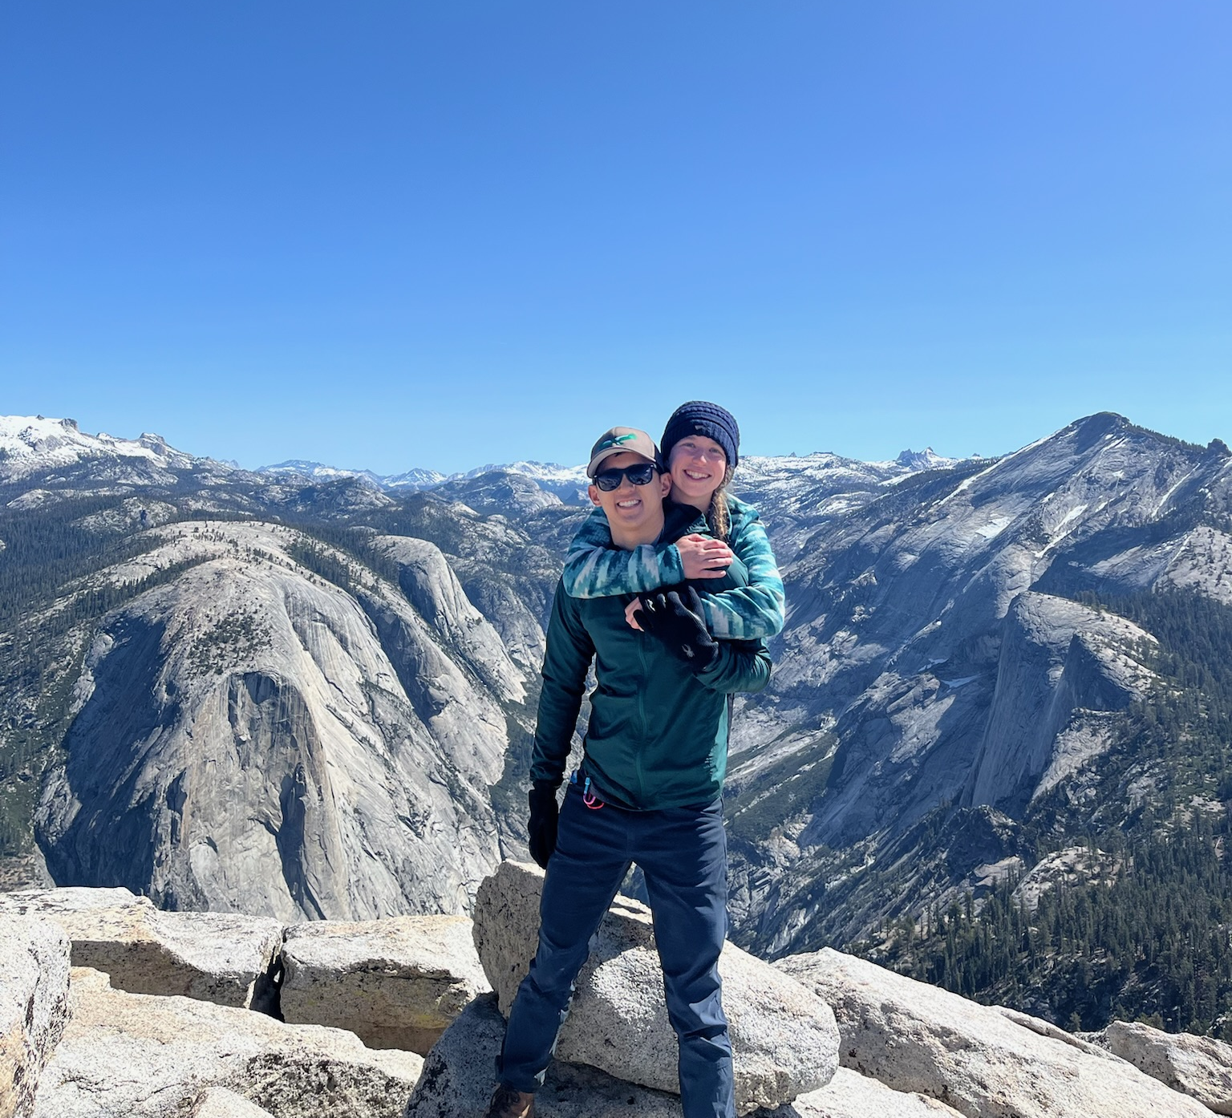
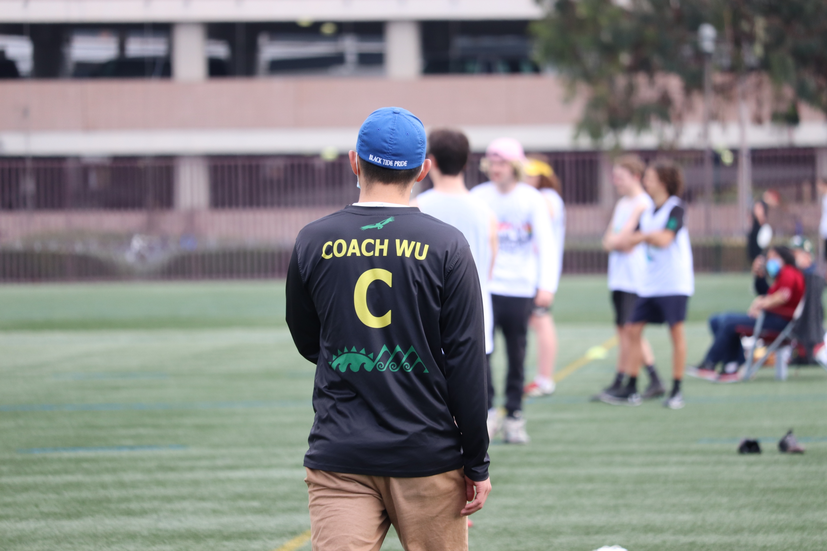
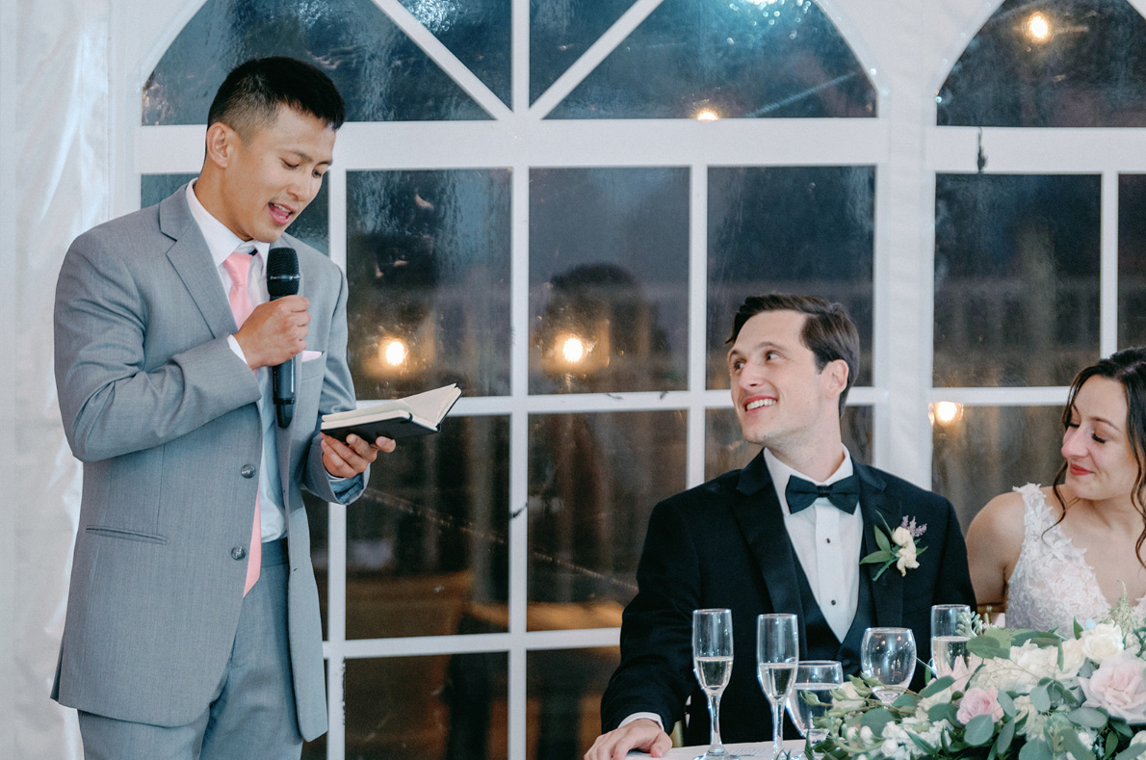
Important (Expanded)
Family & Friendships | Being there for big life moments & milestones (weddings, family trips, celebrations, etc.) I never want to miss an important life event due to a work obligation
Health | Hiking, Traveling, Playing Sports, Eating Right
Adventures | Exploring a new city, Traveling to different countries, Connecting with Nature, Having a partner to travel with
Creative Outlets | Travel Videos, Woodshop Projects, Writing
Community | Coaching Sports, FIRST Robotics Team, Volunteering for the local community

Slide 18
Purpose, Priorities, Projects
Priority | Project Example
Personal | Make a highlight video from my adventures in Seattle
People | Create a podcast to catch up with my college friends
Play | Design & 3D Print a modified clipboard for coaching my high school frisbee team
Professional | Reflecting on my career accomplishments and researching prospective companies for my next chapter

Slide 19
Writing
Writing habits that have helped me stay organized and mindful:
Keeping a personal journal – helpful for harnessing emotions after big events
Keeping a work journal – helpful for staying focused in meetings and bookmarking ideas
Sticky Notes for Tasks throughout the Day & Week
Journaling Spreadsheet on my phone (Daily Rose/Thorn/Bud)
Writing helps me slow down my racing thoughts

Slide 20
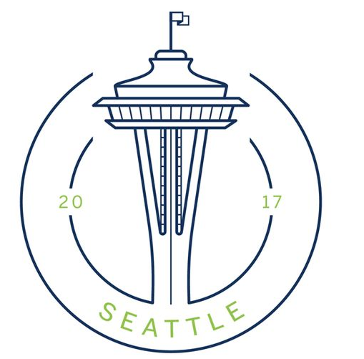


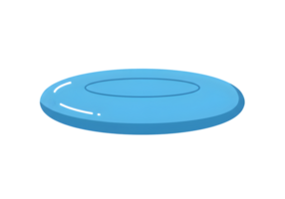
The Gap vs The Gain
Things I’m proud of:
Worked for different companies & industries
Completing my Master’s degree
Taking the leap to live in a different city
Having a lasting impact on community and integrating into a new one
Maintaining relationships with my friends, family, and girlfriend

Slide 21


Chapter Analysis
Santa Barbara, CA
Seattle, WA
Next Chapter?
Relationships
Health
Career
Personal

Slide 22
My Next Chapter
Phase I
Reflection
Phase II
Action
Phase III
Transition
Reflect on Life Goals
Determine next chapter with Naomi
Career Priorities
Research Prospective Companies & Roles
Compile Network for next chapter location
Practice Interviews
Apply to Positions
Determine Logistics (Timing, Moving, etc.)
Set Goals for next chapter
Post Transition Reflect

Slide 23
Career
Must Haves
Nice to Haves
Must Not Haves
My Ideal Work
Hybrid Work
Good Team
Good Manager
Salary
Aligned Product
Short Commute
Have my mornings back
Notes:
In some ways I miss my role at RVS because I had a great relationship with my manager and team
I realized that came with time and effort and built relationships
Slight

Slide 24
Exercise: What I Want for the next Career Step
What I want to do differently for my next career
Personal:
Live with my girlfriend
Establishing Roots & Community
Take back the mornings
Work
Have a different attitude to work
Currently see it as this evil entity // Need to see it as a more positive relationship
Lower my walls // Find that balance of setting boundaries but letting people in and being more open & transparent

Slide 25
Future / Conclusion
Hard to fit all my lessons learned in one slide but here are the most important ones I’ve found across the industries
Build trust & relationships with the people doing the work (technicians, mechanics, operators, etc.)
Put in the work first / attempt a problem before asking for direction guidance from a professor or mentor

Slide 26
Taking Action

Slide 27
Actions
Bailey In Between
Exercises
Side Projects
Interview Prep
Welcome Pod
Personal User Guide
3D Printing
Technical Q’s
Career Recap
BEYL Summary
Coaching Clipboard
Situational Q’s
Next Chapter Prep
The Gap vs Gain
Closet Board
Fundamental Q’s
Text
Text
Text
Company Research
Text
Text
Notes:
Self Podcast Purpose
Operation Finding My Voice
Turning my reflections Out Loud
Jumbled Thoughts → Writing helps me get it out and organize my thoughts → Speaking helps me share my knowledge and convey my thoughts
Explaining topics help me understand things more
Topics I want to Cover:
Career
Reflections
Project Recaps
Engineering Explanations
Funny Engineering Bits
Life Reflections
Example Episodes
Title
Category
Description
Welcome to the Pod
Discussing the Purpose of the Pod and what to expect
Self Interview (Broad Career Recap / Doesn’t have to be cheesy)
Career
Simulate a self interview and broadly recap my career
Three Chapters of
Manufacturing
Materials & Process
Tooling Design
Lessons Learned:
Documentation
Preparing for my Next Interview
Career
Episode to Prepare me for my next interview. Obviously this whole project is to prepare for that but these questions are specifically tailored to what I expect to answer in my new position and be honest with myself and look inward on my value as an engineer
Fundamental Mechanical Concepts
Engineering
Explaining Fundamental Mechanical Concepts to a 5 year old or High Schooler – where common ME Concepts can be applied & be cool
Explaining different mechanisms in Engineering (Motors, Transistors, Pumps, … , etc.)
What makes a good Mechanical Engineer
Top 5 Times [Mechanisms] went GOD MODE
Engineering
Funny Tone Change of Ranking Mechanisms
Mylar/BoPet – Pop Tarts & Space Craft
Materials
Engineering
Discussing Materials as a Laser Weld Project Owner
Materials Matrix from Efficient Engineer
Airplanes
Engineering
Discussing the Lessons Learned about Aviation
Getting Technical (Projects)
Engineering / Career
Deep Dive of Technical Projects of My Career
Examples of STAR Method of different chapters of my career (Manufacturing, Process, Tooling Design)
Video Project Example
Leadership
Life
Discuss the different styles of leaderships I’ve experienced and what works for me and the lessons I’ve learned
Personal User Guide
Life
Things I’ve learned about myself as an employee (and human being)
Structure
Deadlines
Walking to Reset
Long Distance
Life
What Long Distance has taught me
(Friendships & Romantic Relationships)
Chinese Podcast
Life
Try Recording a podcast in Mandarin to improve my Mandarin!

Slide 28
5-3-1 Exercise
5 Companies Interested in
3 People
1 Interview

Slide 29
The Gap vs The Gain
Worked for different companies & industries
Earned a Master’s degree while working full time
Able to live in a different city on my own
Able to have a lasting impact on community and integrate into a new one
Able to maintain relationships with my friends, family, and girlfriend

Slide 30
EYL Exercises
The Gap vs The Gain
Journal Entries
The Ideal Life / What’s Important to Me
5-3-1

Slide 31
Finding My Voice
Informational Interviews
Coaching
Connecting with old friends (Fantasy Football Podcast)

Slide 32
Favorite Quotes
“Pressure is Privilege”
“You did the best you could with what you had”
Eat your vegetables

Slide 33
Habits Formed after EYL Challenge
Always had a journal while traveling so I’ve understood the power of writing but I recently added a daily personal journal and a work journal
Sticky Notes to prepare my week
Fun to look back on the journal entries
Documents my life in a way
Mornings unfortunately not an option

Slide 34
Informational Interviews
Candidates:
Snuff
Ryan (NK’s coworker)
Chris Pham
Jake Kennington
Nick
Mark Bryne (Tooling Engineer)

Slide 35
Mark Bryne (Tooling Engineer)
NWA Upgrade Plane to 737
Wash → Primer → CIC → Floorboards
Mark Bryne
Originally from UK
Worked at BAE, Site was winding down closing up
Lots of promotions for Boeing contracts to convert 747 into Dreamlifters
Decided to take a chance at 34 and moved with his girlfriend to the States with a suitcase
“If I don't do it now, I'll regret it later.”
Thought it was going to be a 1-2 year stint and go back to UK
Now been here for 20 years and never looked back
Contract to Boeing
Started as an Equipment Engineer and didn’t understand the job role
Just wanted to get his foot in the door at Boeing
Took on the ASM Area and created his own role through mechanical design
Established Tooling Engineer and comfortable with his position

Slide 36
Journal Entries
Text TBD

Slide 37
Exercise: What I Want for the next Career Step
What I want to do differently for my next career
Personal:
Live with my girlfriend
Establishing Roots & Community
Take back the mornings
Work
Have a different attitude to work
Currently see it as this evil entity // Need to see it as a more positive relationship
Lower my walls // Find that balance of setting boundaries but letting people in and being more open & transparent

Slide 38
Interviewing Myself
Insert Podcast Link

Slide 39
Operation: Finding My Voice
Moving to a new community, I found myself listening more and absorbing my experiences
I’ve realized I’ve become more reserved and more introverted and I noticed myself becoming invisible
In my old community, I used to be seen and involved
Operation “Finding My Voice” is my attempt to get my voice back – to get that feeling again
Objectives:
Talk to others
Bring people together
Go to more social events & Be more involved in the community
Use Creativity as a digital microphone
Speaking out more / Not being afraid of rejection

Slide 40
Career
Personal Intro
Manufacturing
Process
Design
Product: FPA
Process Overview
Tooling Overview
Product Lifecycle
Space Products
RCCA
Laser Weld
Capital Project
Metallurgy
Automation
Empennage
BL0 Project
PCU Safety Project
Technical Q’s
Company Research
Situational Q’s
My Q’s to Them
Common Q’s
Notes:
Self Podcast Purpose
Operation Finding My Voice
Turning my reflections Out Loud
Jumbled Thoughts → Writing helps me get it out and organize my thoughts → Speaking helps me share my knowledge and convey my thoughts
Explaining topics help me understand things more
Topics I want to Cover:
Career
Reflections
Project Recaps
Engineering Explanations
Funny Engineering Bits
Life Reflections
Example Episodes
Title
Category
Description
Welcome to the Pod
Discussing the Purpose of the Pod and what to expect
Self Interview (Broad Career Recap / Doesn’t have to be cheesy)
Career
Simulate a self interview and broadly recap my career
Three Chapters of
Manufacturing
Materials & Process
Tooling Design
Lessons Learned:
Documentation
Preparing for my Next Interview
Career
Episode to Prepare me for my next interview. Obviously this whole project is to prepare for that but these questions are specifically tailored to what I expect to answer in my new position and be honest with myself and look inward on my value as an engineer
Fundamental Mechanical Concepts
Engineering
Explaining Fundamental Mechanical Concepts to a 5 year old or High Schooler – where common ME Concepts can be applied & be cool
Explaining different mechanisms in Engineering (Motors, Transistors, Pumps, … , etc.)
What makes a good Mechanical Engineer
Top 5 Times [Mechanisms] went GOD MODE
Engineering
Funny Tone Change of Ranking Mechanisms
Mylar/BoPet – Pop Tarts & Space Craft
Materials
Engineering
Discussing Materials as a Laser Weld Project Owner
Materials Matrix from Efficient Engineer
Airplanes
Engineering
Discussing the Lessons Learned about Aviation
Getting Technical (Projects)
Engineering / Career
Deep Dive of Technical Projects of My Career
Examples of STAR Method of different chapters of my career (Manufacturing, Process, Tooling Design)
Video Project Example
Leadership
Life
Discuss the different styles of leaderships I’ve experienced and what works for me and the lessons I’ve learned
Personal User Guide
Life
Things I’ve learned about myself as an employee (and human being)
Structure
Deadlines
Walking to Reset
Long Distance
Life
What Long Distance has taught me
(Friendships & Romantic Relationships)
Chinese Podcast
Life
Try Recording a podcast in Mandarin to improve my Mandarin!

Slide 41
“Tell me more about yourself”
Sure, I’m Bailey – my background is in mechanical engineering – I hold a masters & bachelors in mechanical engineering
I’m currently a Tooling Design Engineer for Boeing
I work the 777 program, specifically the empennage section which is the tail of the plane
My role consists of designing tooling that supports manufacturing and design for the plane
Prior to Boeing, I worked for Lockheed and Raytheon where the product I was working on was significantly smaller – a sensor that detects infrared that would go on fighter jets and on space satellites
My role consisted of Materials & Process Engineering where I owned processes and automation
To Manufacturing Engineering where I had ownership of specific programs and responsible for the lifecycle
So the TLDR is – Mechanical Engineer with Aerospace Experience that has performed in different roles in different environments.

Slide 42
Tooling Design Engineering Overview
Empennage
Horizontal Stablizier
Vertical Fin / Rudder
Tail Cone
Typical Tooling Roles
Recurring & Non Recurring
Recurring being the everyday fixing tools, dispositioning, procurement, etc
Lets me use my project management skills
Non Recurring being the big projects that address design configuration / safety
Lets me use my creative side
Bl0 Project
Design change to eliminate Titanium Fittings driving change to build
Fittings hard to install & maintain –
By removing them, they had to add structural integretiy elsehere and implement design changes
One change is the Buttline 0 project where the join of the horizontal stablizier used to be one segmented

Slide 43
Stories Arsenal
Technical Win
Failure or Recovery
Tradeoff decision
Cross-Functional Conflict
Process Improvement
Leadership / Ownership

Slide 44
High Level Explanation of Airplane Mfg
(60 seconds)
If I were to explain the Boeing Everett Site Factory in less than a minute (and my role)
MSDC
Supplier Parts (from Japan, Italy,) → MSDC → AFT SI → Final Body Assembly
Tooling Suppliers from local shops or Off the Shelf item

Slide 45
High Level Explanation of Infrared Detector/FPA
(60 seconds)
If I were to explain the Dewar product in less than a minute (and my role)
At my previous roles in Process & Mfg, I worked on a product called IDDCA which is basically a mouth full for an infrared sensor and in the context of
Application: Space Satellites / Fighter Jets /
Cleanroom environment
Happy to go into more technical detail if you’d like

Slide 46
Process Engineering Overview
My Process Engineering chapter I wanted to explore a more technical route in my career – the competitor had an open position and I took it
Alignment Automation –
Laser Welding –
Laser Weld Definition
Context of FPA & Dewars
Process Engineering Practices
Coupon Testing // Leak Check
Cpk
Reducing Variation & Outliers & Out of Control Process Trends
Notes:
Laser Welding & Alignment Automation
Explain where Laser Weld is involved in the process
Laser Weld Overview
Explain where Alignment is involved in the process
Alignment Overview

Slide 47
Manufacturing Engineering Overview
First job out of college
Space Program – followed a program from cradle to grave
Space Requirements (Vacuum Bake, Outgassing, Cold Temperatures)
By following the product, I was able to see many different processes
Alignment, Wirebonding, Vibration Testing, Thermal Cycling, Adhesives
Cleanroom environment

Slide 48
Common Situational Questions
“Why would you be a good fit for this role?
My versatile background in different roles and industries aligns with Atlen’s diverse portfolio of products
Cleanroom Sensors to Commercial Aircrafts
Manufacturing / Materials & Process / Design
Product Lifecycle (Concept to Design)
Understanding the bigger picture
Customers Upstream & Downstream

Slide 49
Common Situational Questions
“What was your reason for leaving each role?”
Growth
Mfg → Process : Challenge myself from a technical perspective
Process → Process: Leadership opportunity
Process → Design: Working on a new product & aligned
Early Career Focus is Development and Growth
Seeing the product from different angles
Working on Aircrafts give me pride and seeing my impact in everyday life
Some companies do a rotational program to be exposed to different roles and I took the scenic route
But now I have a better understanding of what I want in a new role
Good team / Bigger Picture / Creativity to use my technical engineering skills / Opportunity to go beyond Individual Contributor and Manage a program or team
Sometimes you have to prioritize your career // Sometimes you have to jump even if youre not sure

Slide 50
Stories Arsenal
Tooling
PCU Safety
BL0
Process
MRSI
Laser Weld Capital Project
Mfg
Goldwing
Friday evening
Technical Win
Failure or Recovery
Tradeoff decision
Cross-Functional Conflict
Process Improvement
Leadership / Ownership
Notes:
Technical Win
Laser Weld Capital Project
Goldwing
Failure or Recovery MRSI Automation Story
PCU Safety Project
Tradeoff decision Designing to one project vs multiple
Cross-Functional Conflict
PCU Project of Safety & Ergonomics
Process Improvement
Writing Alignment Programs
Writing a Script to auto data entry
Leadership / Ownership
Laser Weld Capital Project
High Pressure Situation
MRSI Automation Story
A Learning Growth Story
Making a mistake on a Friday due to schedule pressure
Story Telling:
-Context
-My Role
-Key decision
-Result
-Lesson
That’s it
Realizing Tooling isn’t just about CAD & Modeling
Design is a mindset – understanding how everything works and comes together

Slide 51
Stories Arsenal: BL0
Technical Win
Failure or Recovery
Tradeoff decision
Cross-Functional Conflict
Process Improvement
Leadership / Ownership
Story Telling:
Context:
New Design Change: Titanium Fittings Causing Design changes throughout build
MSDC Team have to redesign new build process and require new tooling
My Role
Design new Tooling // understanding the process
Key decision
Airbag Process
Result
Ongoing // Designs submitted
Lesson
Working with different teams in aircraft context [Improve]
That’s it

Slide 52
Stories Arsenal: PCU Safety Project
Technical Win
Failure or Recovery
Tradeoff decision
Cross-Functional Conflict
Process Improvement
Leadership / Ownership
Story Telling:
Context:
Safety issue with PCU Installation // Finger jammed // Rudder to Vertical Fin Process
My Role
Design new tooling to make it easier for mechanics to install rudder to prevent safety hazard
Key decision
Different avenues to solving a problem
Result
Small issue with lifting / negotiating with Ergonomics [Polish]
Lesson
Different avenues to solving a problem
Done is better than perfect
That’s it

Slide 53
Stories Arsenal: Laser Weld Capital Project
Technical Win
Failure or Recovery
Tradeoff decision
Cross-Functional Conflict
Process Improvement
Leadership / Ownership
Story Telling:
Context:
Old Laser Welding Machine breaking down
My Role
Buy a new Laser Welding Machine juggling program, factory, facilities, capital leadership board
Key decision
Exact same welding machine
Result
Integrated Machine into Factory
Lesson
Program Management Skills
Considering different departments perspectives
That’s it

Slide 54
BL0 Project
Technical Win
Tradeoff decision
Process Improvement
Leadership / Ownership
Context One project that my team is going through right now is a design change for the joining of the Horizontal Stabilizer. There was an airplane configuration update where specific fittings were experiencing corrosion issues in the field so there was a drive to replace the fitting with a different material. | My Role So my team was responsible for identifying the tooling needed to be updated and develop new tooling to conform to manufacturing the new design One of the projects I owned was a tool with an airbag to apply a certain force to the join of the Horizontal Stabilizers during its cure process
Actions Without getting too technical I made sure I documented the old manufacturing process and understand the perspective of the mechanics using the existing tool Then I analyzed the requirements we needed to meet with both the existing design and new updated design. And any differences the new tool needed to address I took the existing design model, and modified specific components to address the new requirements Lots of design reviews, simulation modeling, stress analysis, meetings with the manufacturing suppliers | Results/Lessons Learned So in the end, our tool package is submitted and we’re currently waiting for the parts to arrive so we can run through a First Tool Use process. What I learned about designing this tool is that there’s often no one “right” path for a goal and it’s important to understand the main requirements that we must meet

Slide 55
Laser Weld Capital Project
Technical Win
Tradeoff decision
Cross-Functional Conflict
Process Improvement
Leadership / Ownership
Context Old Laser Welder Long Calibration Times, Obsolete Parts, Risk of Single Point Failure | My Role Laser Weld Process Engineer Realized it was more of a program management role Million Dollar Machine
Actions Decided to go with the same modern welder but so much more actions: Provide Justification Present to CCB Board Work with Supplier & Vendor Work with impacted production programs Work with Facilities & Factory Managers Develop Contingency plans | Results/Lessons Learned What I thought was going to be a relatively simple process of copy and paste turned to be one of the most extensive projects But it taught me that when you’re purchasing an equipment for the site of that value, it’s not just treated like a machine but more of an investment to the site which understandably requires more intention and structure.

Slide 56
Goldwing Project
Leadership/Ownership, Cross-Functional Conflict
Recovery / Failure
Context When I was a Process Engineer at Raytheon, there was a program that needed more structure and organization. Because there was another process engineer that wasn’t really providing updates and the data would be really disorganized and I think he came from a program that didn’t necessarily have the same culture of a space program so | My Role Since I had previous experience on Space Programs from my role as a Manufacturing Engineer so I was familiar with the expectations of what program management wanted in terms of the cadence and urgency and visibility. My manager moved me to this program to give more spark and transparency
Actions So I made a plan to understand the program’s needs from process engineering group. I scheduled daily tag up meetings with this individual. I worked with him to create a template on his data to present better. I took on the primary role for communicating and updating the program management so he could be more focused on the technical work – I was almost a translator for him | Results/Lessons Learned And slowly but surely we were able to get the program to the finish line and deliver the modules to the customer. The lesson I learned was that even though this individual seemed hard to work with at first, once I got to spend time with him and understand his cadence more, I found out that he was actually a brilliant engineer but maybe lacked a few soft skills to showcase and communicate his work. It reminded me that everyone has something valuable to offer; sometimes, they just need a little help to show it.

Slide 57
Structuring Each Question
Context “ I would say my mind goes to ….” | My Role For example,
Actions “And that’s important because…….” | Results/Lessons Learned So what I learned is….

Slide 58
Lessons Learned
Documentation – Writing things down can save time in the future
Curiosity – Continue to ask “why” to understand the bigger picture
Collaboration – Be able to work with people of all backgrounds
Notes:
Hard to fit all my lessons learned in one slide but here are the most important ones I’ve found across the industries
Build trust & relationships with the people doing the work (technicians, mechanics, operators, etc.)
Challenges are easier with a supportive team
Put in the work first / attempt a problem before asking for direction guidance from a professor or mentor

Slide 59
Favorite One Liners
Asking better questions will get you better answers
Done is better than perfect // Paralysis by Analysis
Get the same story from different people
Pick Two: Cost / Quality / Schedule

Slide 60
Stories Arsenal: MRSI Board Issue
Technical Win
Failure or Recovery
Tradeoff decision
Cross-Functional Conflict
Process Improvement
Leadership / Ownership
Story Telling:
Context:
MRSI Heating component not working
My Role
Process Engineer in charge of machine
Key decision
Working with Suppliers
Electrical Schematic // Diagnosing the problem
Result
Ordered Small components, replaced, solved
Lesson
Root Cause Analysis from Manufacturing days really helped
That’s it

Slide 61
Stories Arsenal: Goldwing Program
Technical Win
Failure or Recovery
Tradeoff decision
Cross-Functional Conflict
Process Improvement
Leadership / Ownership
Story Telling:
Context:
There was a Space Program that needed more organization and transparency
My Role
I had previous experience on Space Programs that required a specific cadence and urgency. My manager moved me to this program to give more spark and transparency
Key decision
Working with process engineer that was brilliant but just lacked some soft skills and social skills
Worked with him extensively, got to know him on a personal level and understand him more. A lot of people viewed him negatively but I just gave him structure to showcase his work (Penn & Teller analogy)
Result
Program was solved and delivered and customer was happy
Lesson
Some people are misunderstood and just need guidance
That’s it

Slide 62
Alten Research
Raleigh Site
Greensboro – Automotive
Diverse Portfolio of services & clients

Slide 63
Questions for Alten
What does growth look like at Alten?
Individual Contributor to Management?
How does Alten balance the standardization of different industries
Example: Is there a challenge of having different Regulatory agencies like FDA for LifeSciences or FAA for Aerospace or __ for automotive?
Politely ask if Mechanical Engineer II was a mistake given someone of my background and years of experience
Upcoming projects for Alten for the next few years
Clearly there is a need and demand for this job req

Slide 64
Presentations
Manufacturing
Process
Design
High Level Explanation of Infrared Detector/FPA
Explain Hexapod Alignment Using Matlab & Rodrigo’s Formula
Laser Welding in a Nutshell
Metallurgy Lessons & Composites
Tolerance Stackup Analysis
Lessons Learned from Commercial Aviation

Slide 65
Presentations
Manufacturing
Process
Design
High Level Explanation of Infrared Detector/FPA
Explain Hexapod Alignment Using Matlab & Rodrigo’s Formula
Laser Welding in a Nutshell
Metallurgy Lessons & Composites
Tolerance Stackup Analysis
Lessons Learned from Commercial Aviation

Slide 66
Situations
Soft Skills
Leadership
Design
Working with a Vendor/Supplier
High Level Explanation of Infrared Detector
Laser Welding in a Nutshell
Lessons Learned from Commercial Aviation
High Level Explanation of Infrared Detector
Laser Welding in a Nutshell
Lessons Learned from Commercial Aviation

Slide 67
Lower Tier Topics
Manufacturing
Process
Design
High Level Explanation of Infrared Detector/FPA
Explain Hexapod Alignment Using Matlab & Rodrigo’s Formula
Laser Welding in a Nutshell & Coupon Testing
Metallurgy Lessons & Composites
FDSA – Full Determinant Size Assembly

Slide 68
STAR Format
Manufacturing
Process
Design
High Level Explanation of Infrared Detector/FPA
Explain Hexapod Alignment Using Matlab & Rodrigo’s Formula
Laser Welding in a Nutshell
Metallurgy Lessons & Composites
SICK Scanner

Slide 69
BA Mechanical Engr – UC Santa Barbara
Insert Photos of Undergrad
Machine Shop

Slide 70
Manufacturing Engineer – Raytheon
Goleta, California
Dates
Career Impact
Why Did I leave
What Did I Learn
Some Favorite Moments / Stories
Lean Manufacturing Concepts
Six Sigma
Infrared Detector Technology
IDDCA Processes
Working with Technicians & Program Management
Supplier Quality
Space Environment Products
Cleanroom Environment
CMM

Slide 71
Process Engineer – Lockheed Martin
Automation (MRSI)
Alignment
Leadership (PMT)
Technical Direction
Datum Transferring
Goleta, California
Dates
Career Impact
Why Did I leave
What Did I Learn
Some Favorite Moments / Stories

Slide 72
Process Engineer – Raytheon (Pt.2)
Laser Welding
AR Process
Supplier Visits / Relationships
CPK
M&P Processes / Cross Sectioning Coupons
SEM Scanning
Metallurgy
G-Code & Figure 8 Welding
Goleta, California
Dates
Career Impact
Why Did I leave
What Did I Learn
Some Favorite Moments / Stories

Slide 73
Tooling Engineer – Boeing
Aircraft Industry & Commercial Aviation
Tooling Design
Project Lessons Learned
Seattle, WA
Dates
Career Impact
Why Did I leave
What Did I Learn
Some Favorite Moments / Stories
Realizing Tooling isn’t just about CAD & Modeling
Design is a mindset – understanding how everything works and comes together

Slide 74
Tooling Design Engineer
Tooling:
Sick Scanner on Robot has a Safety Field of View to prevent people from entering the area
Sick Scanner Tripped Up Frequently – It would cause the safety scanner zones need to be adjusted constantly and cause delays
Worked with the Supplier (SICK) to incorporate a new scanner that develops a safety field of view algorithm that creates it’s field of view based on indexing features of the MBM & Position
Also developed a stronger bracket that attaches to the safety scanner
Considerations: Needs to protect the scanner but not block the Field of View
Elaborate on Process Prove In and Decision Making Process
Notes:
https://www.laserfocusworld.com/detectors-imaging/article/16552851/exotic-imaging-ir-focal-plane-arrays-enable-imaging-that-is-out-of-this-world

Slide 75
Star Studies
Tooling:
Sick Scanner on Robot has a Safety Field of View to prevent people from entering the area
Sick Scanner Tripped Up Frequently – It would cause the safety scanner zones need to be adjusted constantly and cause delays
Worked with the Supplier (SICK) to incorporate a new scanner that develops a safety field of view algorithm that creates it’s field of view based on indexing features of the MBM & Position
Also developed a stronger bracket that attaches to the safety scanner
Considerations: Needs to protect the scanner but not block the Field of View
Elaborate on Process Prove In and Decision Making Process

Slide 76
Road to North Carolina
Bailey Wu
Mechanical Engineering
January 5th, 2026

Slide 77
Informational Interviews
Contact | Relation
Kayla | LinkedIn Recruiter | Call on 01/08/26 – See Slide
Drew | Scott’s Friend
Jake Thorn | Frisbee Connection
Sam | Friend
 | Naomi’s Director

Slide 78
Person A

Slide 79
Task List
Resume
Revisit & Revise
Submit to UW Resource to Check
Submit to SPEEA Resource to Check
Send to NK
Tailor to certain positions
Notes:
General/Logistics
Determine Location & Create List of Job Requisitions
Refine Resume & Tailor to different Job Codes
Create "Personal Profile" Paragraphs (See Examples)
Practice Interviewing & Public Speaking Practices
Prepare Questions of why I'm leaving / Job Hopper image
Create a Self-Podcast similar to "Being an Engineer" podcast with questions
Fill out Development Profile
Create a Personal User Manual

Slide 80
Personal Profile
Resume
Revisit & Revise
Submit to UW Resource to Check
Submit to SPEEA Resource to Check
Send to NK
Tailor to certain positions
Coaching Appointments – Schedule a 30-minute session to talk about any career-related issue with one of our 4 friendly career coaches. Free for the first 3 years after graduation.
From <https://www.washington.edu/graduation/after-graduation/>
Career Planning Resources – Check out video clips, handouts, online tools, recorded webinars, and other resources available 24/7 so you can work on career stuff whenever you want.
Free Subscriptions for Huskies – Online platforms and products to help you explore careers, build skills, get experience, practice interviewing, and more. https://uw.joinhandshake.com/stu/articles/10372
From <https://www.washington.edu/graduation/after-graduation/>

Slide 81
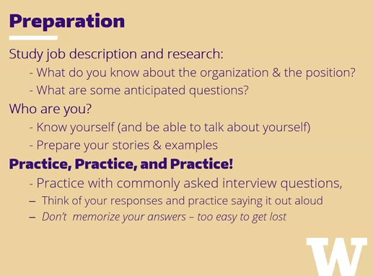
Interview Prep
Interviewing Skills Webinar
https://uw.joinhandshake.com/stu/articles/10372

Slide 82
Interview Prep
Prep

Slide 83
Company Research

Slide 84
Company A

Slide 85
Technical Skills

Slide 86
Some Ideas
Explaining Focal Plane Array Product
Explaining Aircraft Product
Explaining Laser Welding SME
Explaining Alignment
Material Selection -
Review Course Airplane Component Design Material Selection Module 1 (SEU0122-1WEB)
Structures University Resources
Outputs: (Summary Sheet or Educational Video)
Explaining to a 6th Grader

Slide 87
Mechanical Engineering Skillset
Design & Analysis
Manufacturing
Materials Science
Softskills
Sub Specialties
See Notes for Descriptions
Notes:
Design & Analysis
CAD Modeling - Onshape / AutoCAD, SOLIDWORKS, CATIA, Inventor
FEA Analysis Example
Fluid Dynamics Example
3D Printing Examples
GD&T Class
Sub Specialties
Dynamics
Thermodynamics
Aerodynamics
Robotics
Mechanisms
Biomedical
Manufacturing
Process CpK
Automation
Root Cause Analysis
Lean Manufacturing
Materials Science
Materials Presentation
Weekly Reviewing Materials
Choosing Materials in CAD Modeling
Softskills
Materials Presentation
Program Management
Leadership
Mentorship
Presentation Skills
Working with others

Slide 88
Topic A

Slide 89
Soft Skills
Notes:
Topics/Reference:
Buying a Capital Equipment (AR File)
Welding Project - Figure 8 Weld after Gap issues
Draco Specification
Scaling a Process to Production - Engineering to Production
LM Focal Plane Array Overview Slideshow
Process ENB Examples
XMR Charts
Laser Welding
Datum Transferring
CMM
SEM (Scanning Electron Microscopy)
Coupons
Design for Manufacturing - https://www.engineersedge.com/dfm-dfma.htm
Lessons Learned Failures: Boeing FAUB, CWC Paint Project Delays
Spatial Analyzer - SMRs -
Wing crushing Workstand
Safety Requirement stories from Gael & Jordan
Tooling Project with Safety Interlocks
Tooling Project - Robot Sealant Applicator
Structures Design Engineer Page
Engineering Playbook - Material Handling Example- https://playbook.web.boeing.com/Userinterface/Content.aspx?cId=8.5.1
Preparing for New Job Hunting:
Situational
Projects STAR Format
Tooling
Process
Manufacturing
Technical
Metallurgy SME Sheet
Laser Welding
Focal Plane Array 101 Sheet/Summary/Video
Airplane Manufacturing Summary/Lessons Learned/Video
Side Topics
Materials
Alignment
SPC & Lean Manufacturing
Behavioral
Working with others
Risk Management
Look up typical interview questions to answer & practice

Slide 90
Some Ideas
Situational
How would you approach a disagreement with a team member?
Behavioral
Strengths & Weaknesses
Lessons Learned from Industry
Right Results > Rushed Results

